Slide 1
AAAI 2025 · Group Paper Discussion
Enriching Multimodal Sentiment Analysis
Through Textual Emotional Descriptions
of Visual-Audio Content
Sheng Wu, Dongxiao He, Xiaobao Wang, Longbiao Wang, Jianwu Dang
Tianjin University · Shenzhen Institutes of Advanced Technology, CAS
Notes:
Welcome everyone. Today I will present a paper published at AAAI 2025 titled "Enriching Multimodal Sentiment Analysis Through Textual Emotional Descriptions of Visual-Audio Content." The proposed method is called DEVA. I will walk through its motivation, method, experiments, and conclusions.

Slide 2
Outline
1. Background: Multimodal Sentiment Analysis
2. Motivation: Fine-grained emotional drift
3. Key idea and contributions
4. DEVA architecture overview
5. Emotional Description Generator
6. Text-Guided Progressive Fusion
7. Datasets and evaluation setup
8. Main results
9. Ablation and fine-grained study
10. Conclusion and future work
Notes:
The talk is organized into ten parts. We start from the background of multimodal sentiment analysis, then explain the motivation and the proposed DEVA framework, walk through its key modules, and finally present the experimental results and conclusion.

Slide 3
Background: Multimodal Sentiment Analysis
MSA aims to identify a speaker's sentiment by jointly modeling three parallel streams: text transcript, audio, and visual (facial) signals. It has broad applications in social media analysis, human-computer interaction, and healthcare.
Typical pipeline
· Unimodal encoders: BERT for text, Librosa / OpenSMILE for audio, OpenFace for vision
· Fusion: early concatenation, tensor fusion, or cross-modal transformers (MISA, MulT, etc.)
· Output: sentiment class (negative / neutral / positive) or a continuous regression score
Notes:
Multimodal Sentiment Analysis combines text, audio, and video cues to read a speaker's emotion. Modern systems typically encode each modality separately and then fuse them with attention-based transformers. Despite strong results, the authors observe a blind spot: fine-grained emotional changes inside a short video are hard to capture.

Slide 4
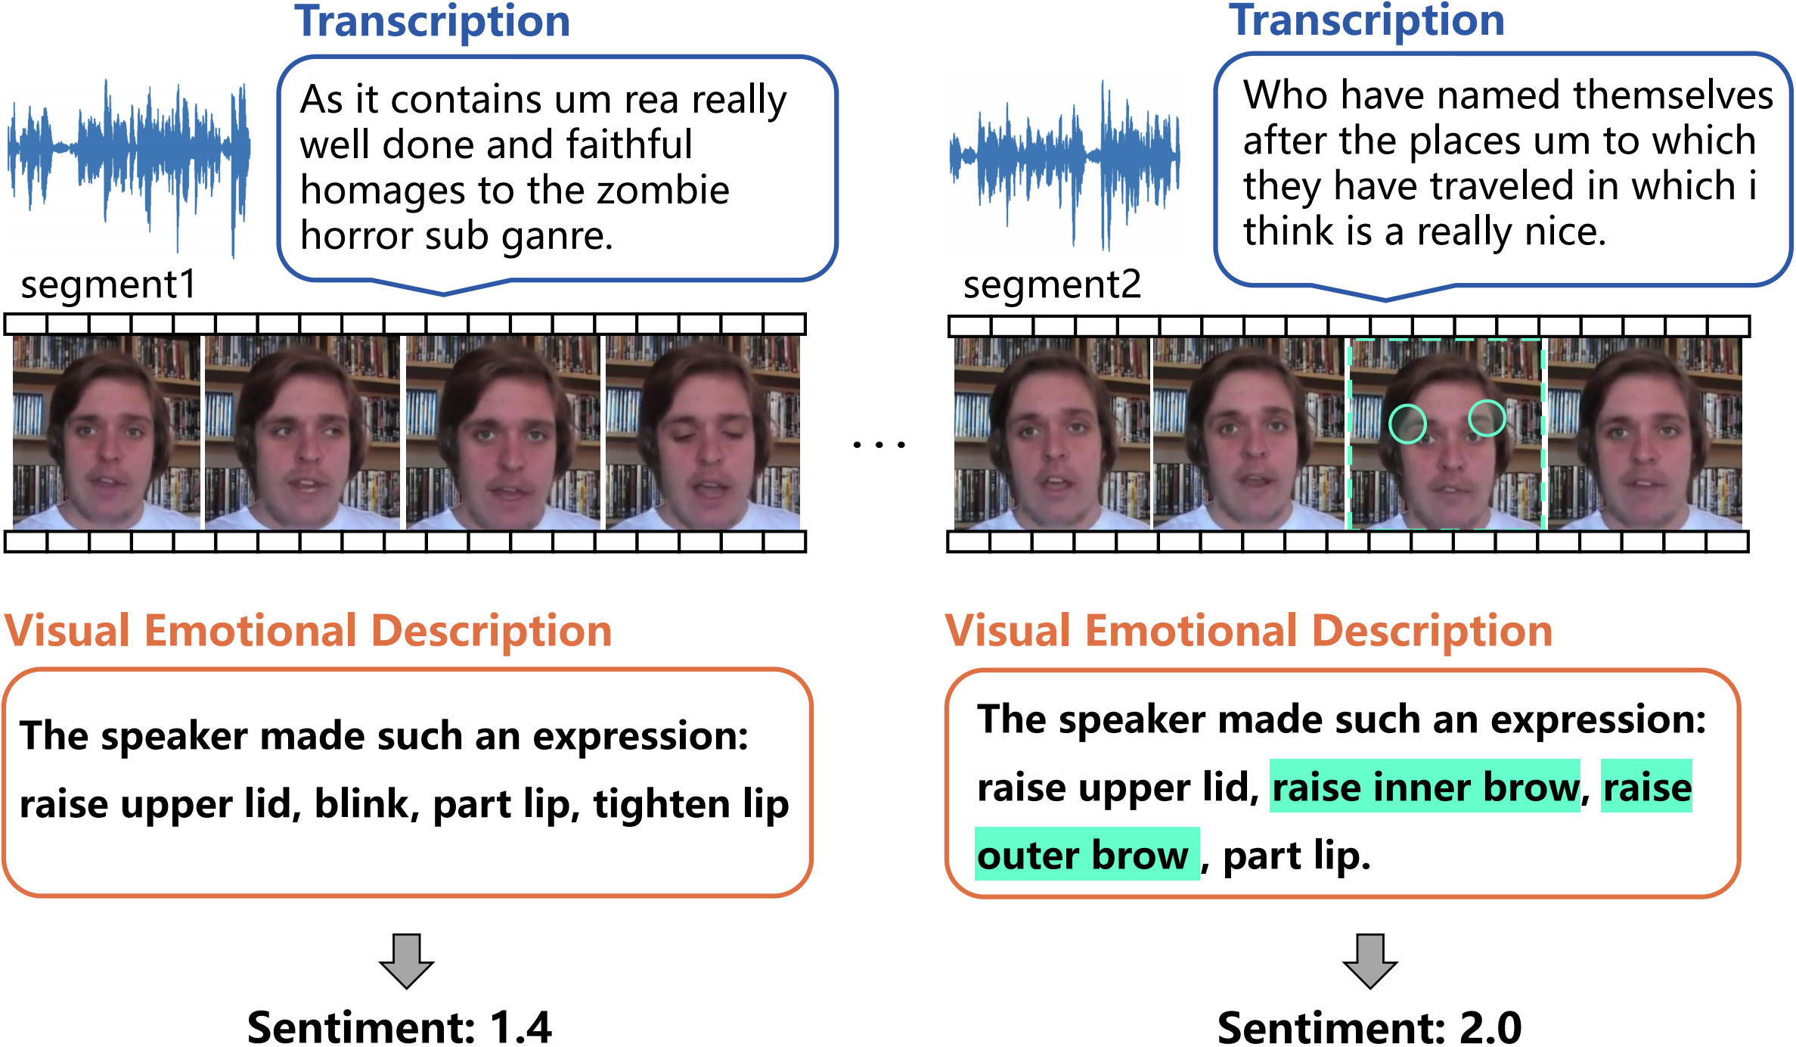
Motivation: Fine-grained Emotional Drift Is Hard to Catch
Two adjacent segments may carry very similar transcript, pitch, and facial action units (AUs), yet the labeled sentiment can flip between negative and positive. Relying on raw features alone, the model cannot tell them apart.
Example from the paper (Figure 1)
· Segment 1: speaker says "I really was disappointed." → Sentiment 1.4 (more negative)
· Segment 2: similar transcript, brow raised, lip tightened → Sentiment 2.0 (more positive)
· Text description "raise inner brow, raise outer brow" makes the micro-expression explicit to the model.
Figure 1
Notes:
The authors point out that raw audio and video features of adjacent segments look almost identical, while the human label differs. The missing signal is the micro-expression itself. A short textual description of the facial action and the prosody makes this micro-signal explicit to the model, narrowing the gap between modalities.

Slide 5
Key Idea and Contributions
DEVA — an Emotional Description Progressive Framework that converts audio and visual signals into textual emotional descriptions, and uses text as the guide to progressively fuse the minor modalities.
1. Emotional Description Generator (EDG): turns prosodic features and facial action units into natural-language emotional descriptions.
2. Text-Guided Progressive Fusion (TPF): uses the text stream as the core modality to iteratively refine audio and visual features, closing the gap between core and minor modalities.
3. Strong empirical results: state of the art on MOSI, MOSEI, and CH-SIMS, with particular improvement on fine-grained 5-class accuracy.
Notes:
The core idea is simple: make the non-verbal streams speak. EDG converts audio prosody and facial action units into short English descriptions, which are then fused with the raw features. TPF then uses the text stream as the anchor to progressively guide audio and visual fusion. The authors report new state-of-the-art results on three standard MSA benchmarks.

Slide 6
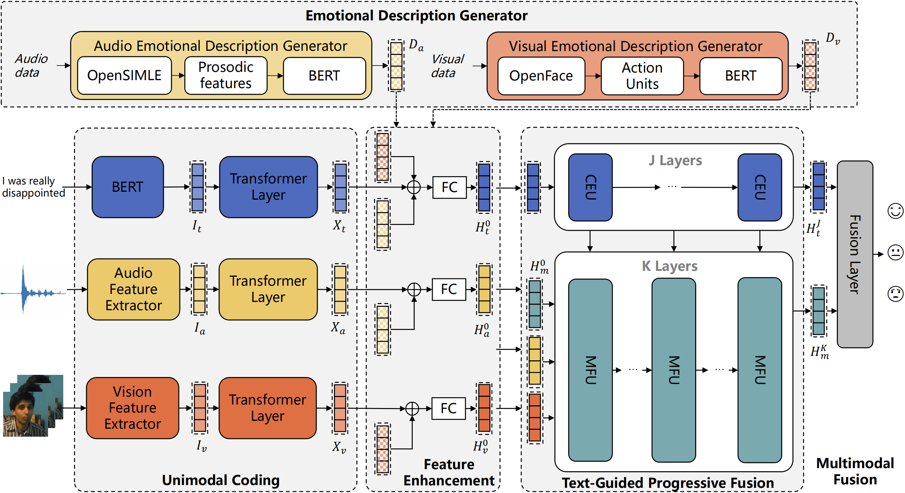
DEVA: Overall Architecture
1. Unimodal coding — BERT for text, audio/visual feature extractors (Librosa, OpenFace); each modality is projected into a unified Transformer representation.
2. Emotional Description Generator (EDG) — prosodic features and facial action units are converted into short textual descriptions D_a and D_v, then encoded with the same Transformer.
3. Feature enhancement — raw features are concatenated with their textual description and passed through a fully-connected layer.
4. Text-Guided Progressive Fusion (TPF) — K layers of Minor-modality Fusion Units (MFU) and core-modality Enhancer Units (CEU), using text as the guide.
Notes:
The pipeline has five stages. First, each modality is encoded separately. Second, EDG produces textual emotional descriptions from audio and vision. Third, these descriptions are fused back with the raw features to enhance them. Fourth, TPF progressively fuses the minor modalities under the guidance of text. Finally, a cross-modal Transformer produces the sentiment prediction.

Slide 7
Emotional Description Generator (EDG)
Audio Emotional Description (AED)
Extracted with OpenSMILE, four prosodic features are each binned into low / normal / high:
· loudness, pitch, jitter, shimmer
Template: "The speaker made such an emotion: pitch, loudness, jitter, and shimmer at different levels."
The resulting text is encoded by BERT into D_a.
Visual Emotional Description (VED)
OpenFace provides 16 facial Action Units (AUs). An AU is kept only if it appears continuously for three frames; the top-k most salient AUs are selected.
Examples: AU01 inner brow raise, AU04 brow lower, AU12 lip corner pull, AU23 lip tighten.
Template: "The speaker made such an expression: k AUs."
Notes:
EDG has two halves. For audio, OpenSMILE gives four prosodic cues that are discretized into three levels and plugged into a sentence template. For vision, OpenFace detects 16 action units; the top-k most frequent ones are described in plain English. Both descriptions are then embedded with BERT and treated as extra textual views.

Slide 8
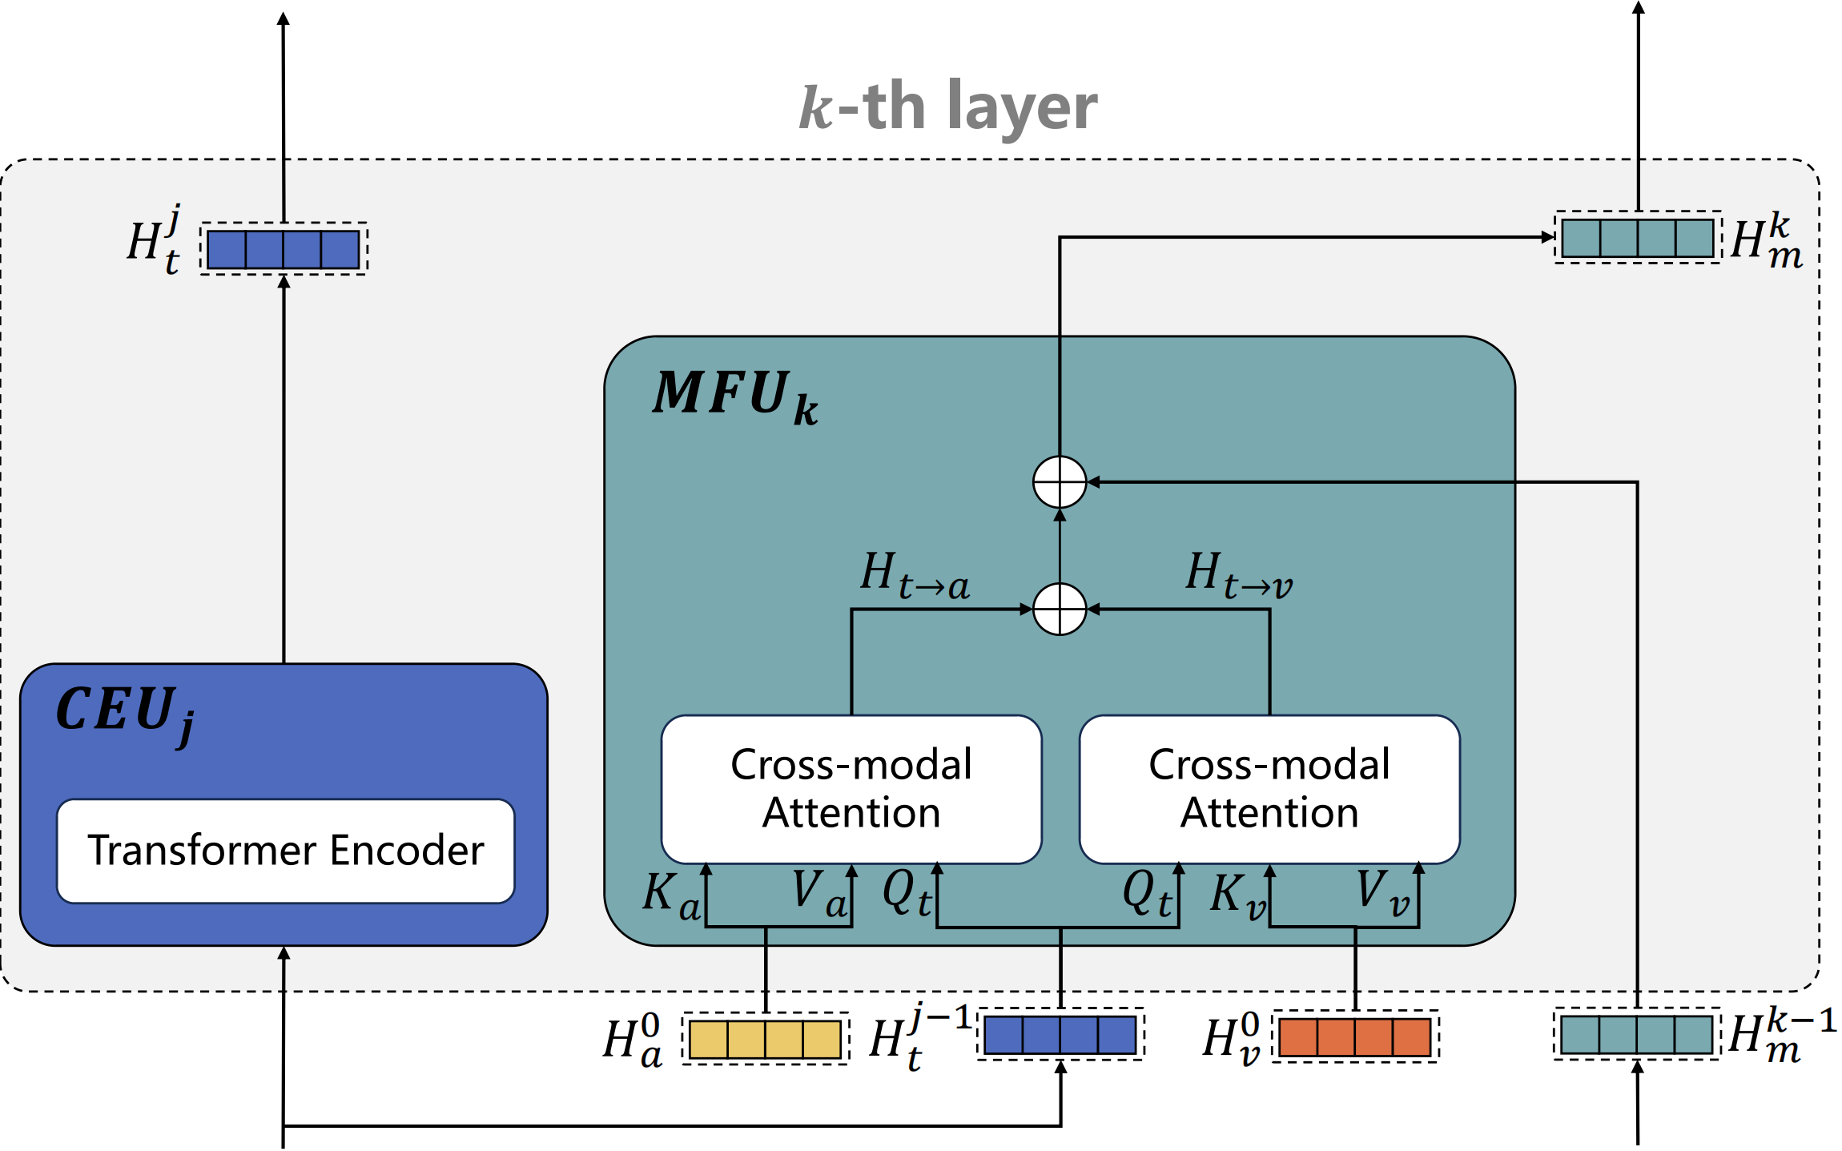
Text-Guided Progressive Fusion (TPF)
Text is treated as the core modality; audio and vision are minor modalities. TPF stacks K = J + 1 layers, each containing a Minor-modality Fusion Unit (MFU) and a core-modality Enhancer Unit (CEU).
MFU — uses the j-th layer's hidden text state H_t^(j-1) as the query Q, and the minor-modality features (audio / vision) as values V. Cross-modal attention iteratively refines the minor features so they align with the current text representation.
CEU — takes the refined minor features and uses them to update the core text hidden state via cross-modal attention, so the text stream also absorbs non-verbal emotional cues.
Final fusion — the core output H_t^(J) and the refined minor features H_m^(K) are fed into a cross-modal Transformer, and a classifier produces the sentiment.
Notes:
TPF is the heart of DEVA. Instead of fusing all modalities symmetrically, it treats text as the anchor. Each layer first lets audio and vision attend to the current text state, then lets text attend back to the refined audio and vision. This progressive exchange narrows the distribution gap between the core and minor modalities.

Slide 9
Datasets and Evaluation Setup
Dataset | Scale | Label
MOSI | 2,199 YouTube monologue clips | Sentiment score from -3 to +3
MOSEI | 23,454 clips from 1,000 speakers | Continuous sentiment score -3 to +3
CH-SIMS | 2,281 Chinese clips from TV / movies | Fine-grained score -1 (negative) to +1 (positive)
Metrics
· Classification: Weighted-F1, 2-class accuracy (negative / non-negative), Acc-2 (negative / positive), Acc-5, Acc-7
· Regression: Mean Absolute Error (MAE), Pearson Correlation (Corr)
Baselines: TFN, LMF, MulT, MISA, MAG-BERT, PMR, MFSA, FDMER, Self-MM, ALMT, ConFEDE
Notes:
The authors evaluate on three standard MSA benchmarks: MOSI and MOSEI in English, and CH-SIMS in Chinese, which is known to be harder because it contains more diverse, fine-grained expressions. They report both classification accuracy and regression metrics, and compare against a strong set of recent baselines.

Slide 10
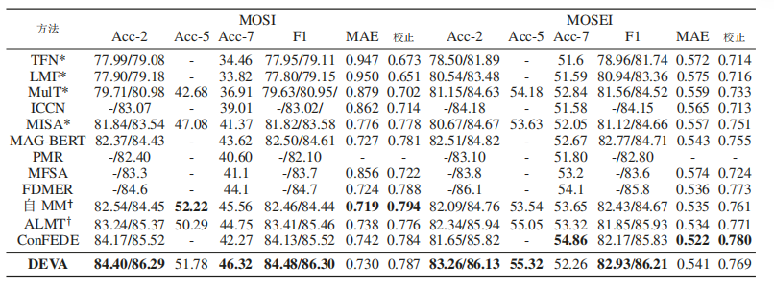
Main Results: DEVA vs. State of the Art
Dataset | Acc-2 | Acc-5 / Acc-7 | F1 | MAE | Corr
MOSI | 84.40 | 51.78 / 46.32 | 84.48 | 0.730 | 0.787
MOSEI | 83.26 | 55.32 / 52.26 | 82.93 | 0.541 | 0.769
CH-SIMS | 79.64 | 65.42 / 43.07 | 80.32 | 0.424 | 0.583
· DEVA outperforms all baselines on Acc-2 and F1 across the three benchmarks.
· On MOSI: +0.65% Acc-7 over the best baseline. On MOSEI: +0.27% Acc-7.
· On CH-SIMS (harder, more fine-grained): +1.05% Acc-2 and +1.34% Acc-5 over the strongest baseline.
Notes:
These are DEVA's headline numbers. Bold entries are the best reported in the paper. The gains are consistent across English and Chinese datasets, and they are largest on CH-SIMS, where fine-grained distinctions matter most. This supports the authors' claim that emotional descriptions help with subtle sentiment changes.

Slide 11
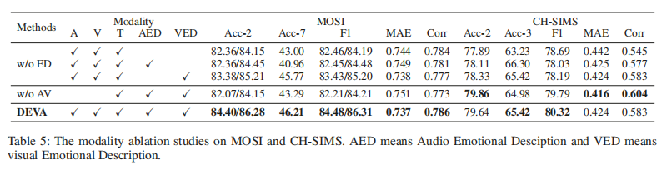
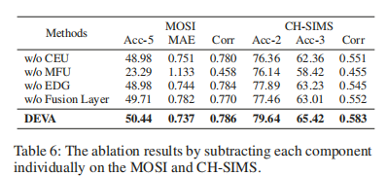
Ablation Study and Fine-grained Analysis
Modality combinations (Table 5)
· Removing AED or VED degrades Acc-2 on both MOSI and CH-SIMS, confirming each description contributes.
· Removing audio-visual raw sources but keeping only text plus descriptions stays competitive on MOSI, and is comparable on CH-SIMS.
Component ablation (Table 6)
· Removing MFU causes the largest drop: progressive fusion is the most important block.
· Removing EDG confirms that textual emotional descriptions boost recognition.
· Removing the final fusion layer hurts overall, highlighting the value of cross-modal interaction.
Notes:
The ablations support the design choices: both audio and visual descriptions matter, and the progressive fusion unit is the single most important component. The fine-grained study on MOSI is particularly telling: DEVA improves the most on the extreme polarity bins, which are exactly the cases where raw features look similar but the human label differs.

Slide 12
Conclusion and Future Work
Conclusion
· Non-verbal emotional cues (prosody, facial action units) can be converted into short textual descriptions and treated as an extra modality.
· Using text as the core modality and progressively guiding audio-visual fusion (TPF) closes the gap between modalities.
· DEVA achieves state-of-the-art results on MOSI, MOSEI, and CH-SIMS, with the largest gains on fine-grained and harder classification settings.
Future work
· Enhance the fluency and naturalness of the generated emotional descriptions, so they more closely match daily human expression.
Notes:
To summarize: DEVA shows that translating audio and visual emotional cues into text, then using text as the anchor for progressive fusion, is an effective and robust recipe for multimodal sentiment analysis. The authors plan to make the generated descriptions more natural and human-like. That ends my presentation — happy to take questions.

